Slide 1
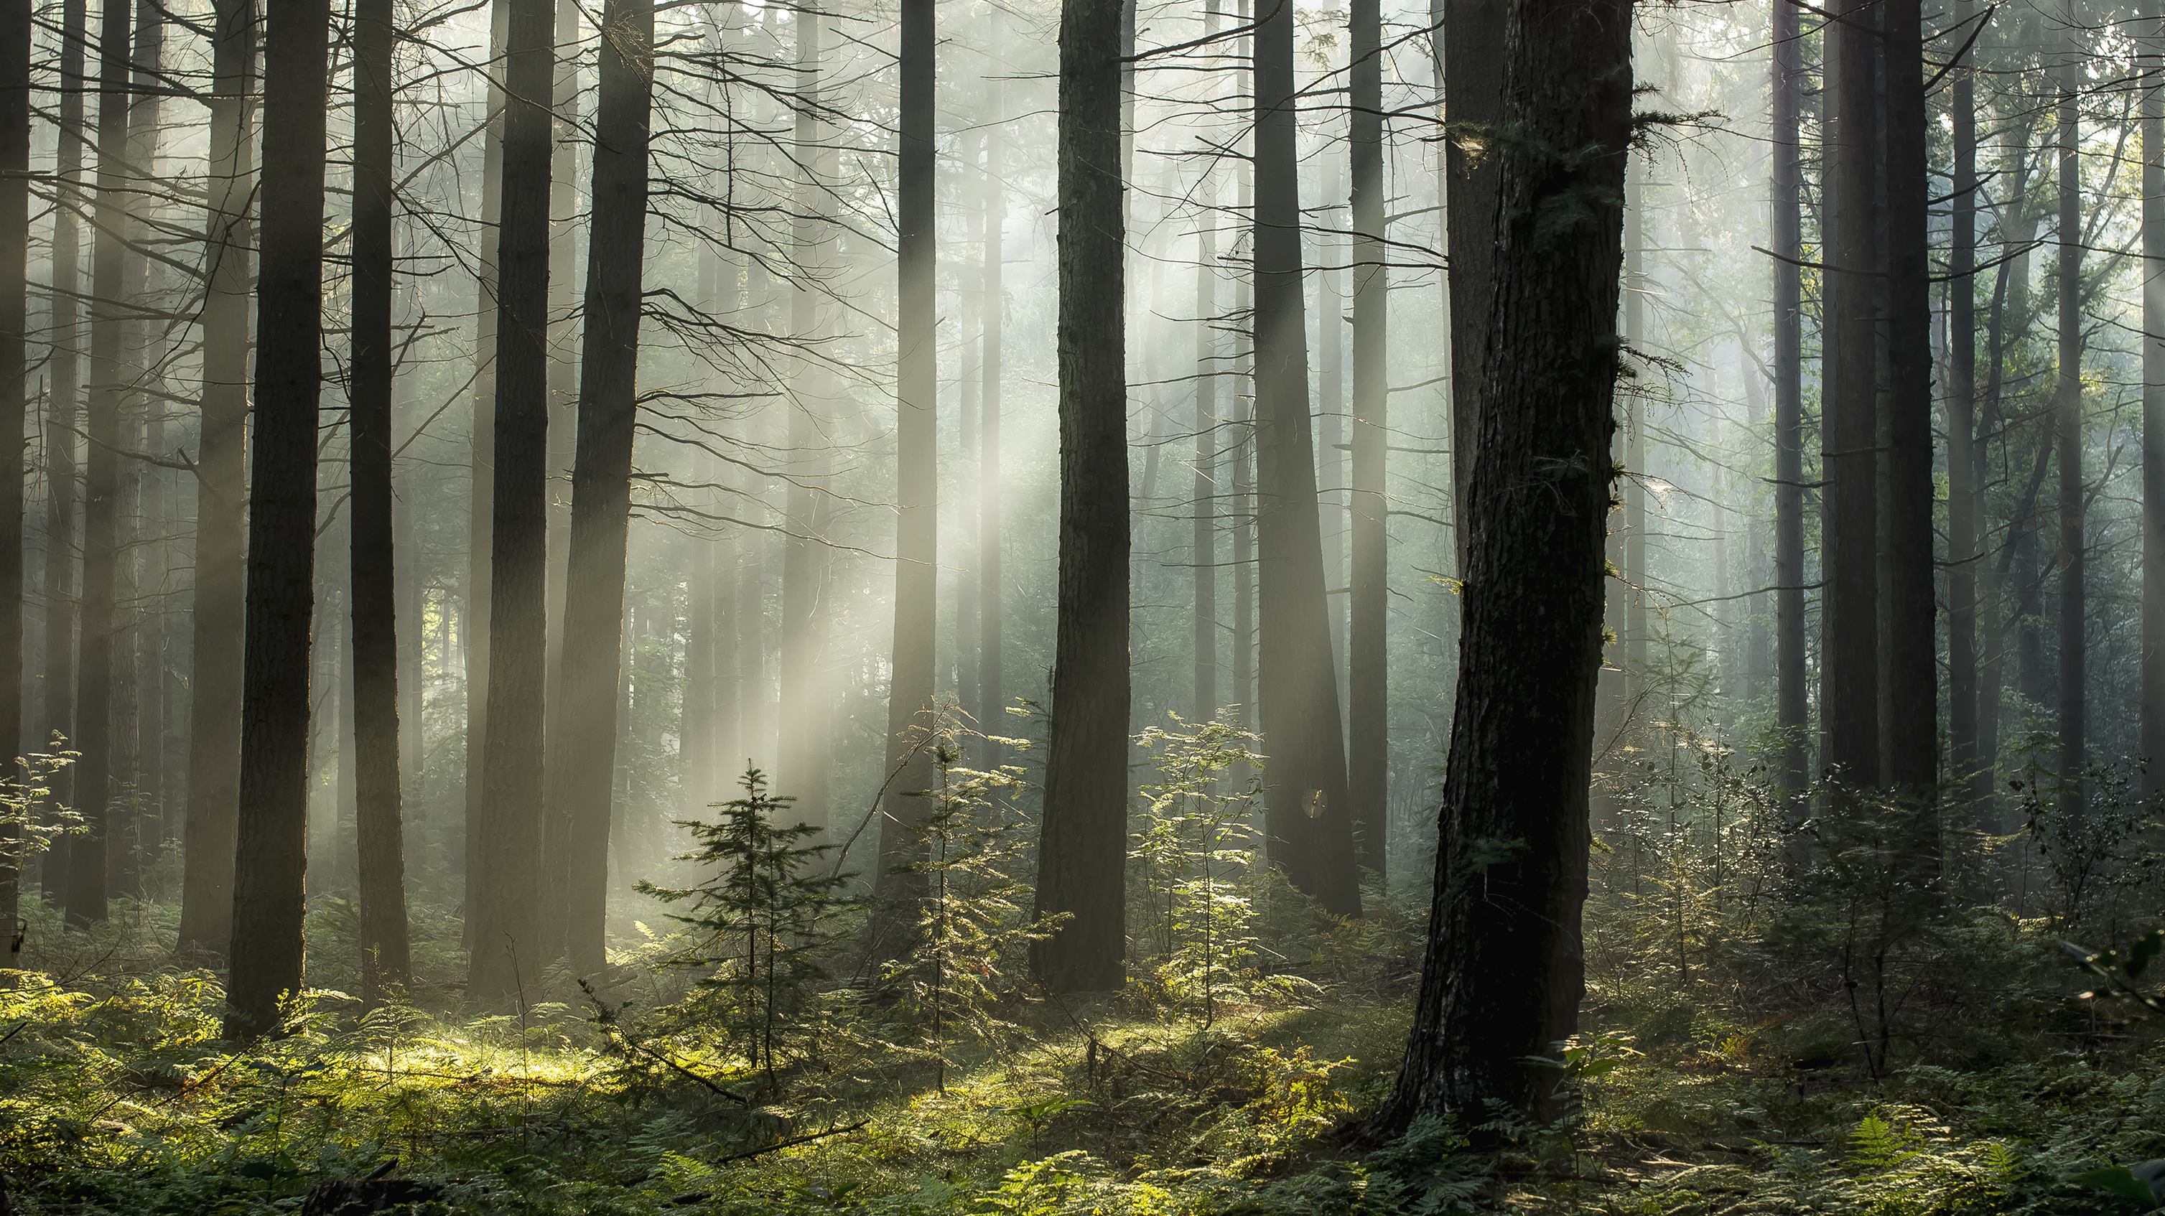
Random Forest

Slide 2

What is Random Forest ??

Slide 3
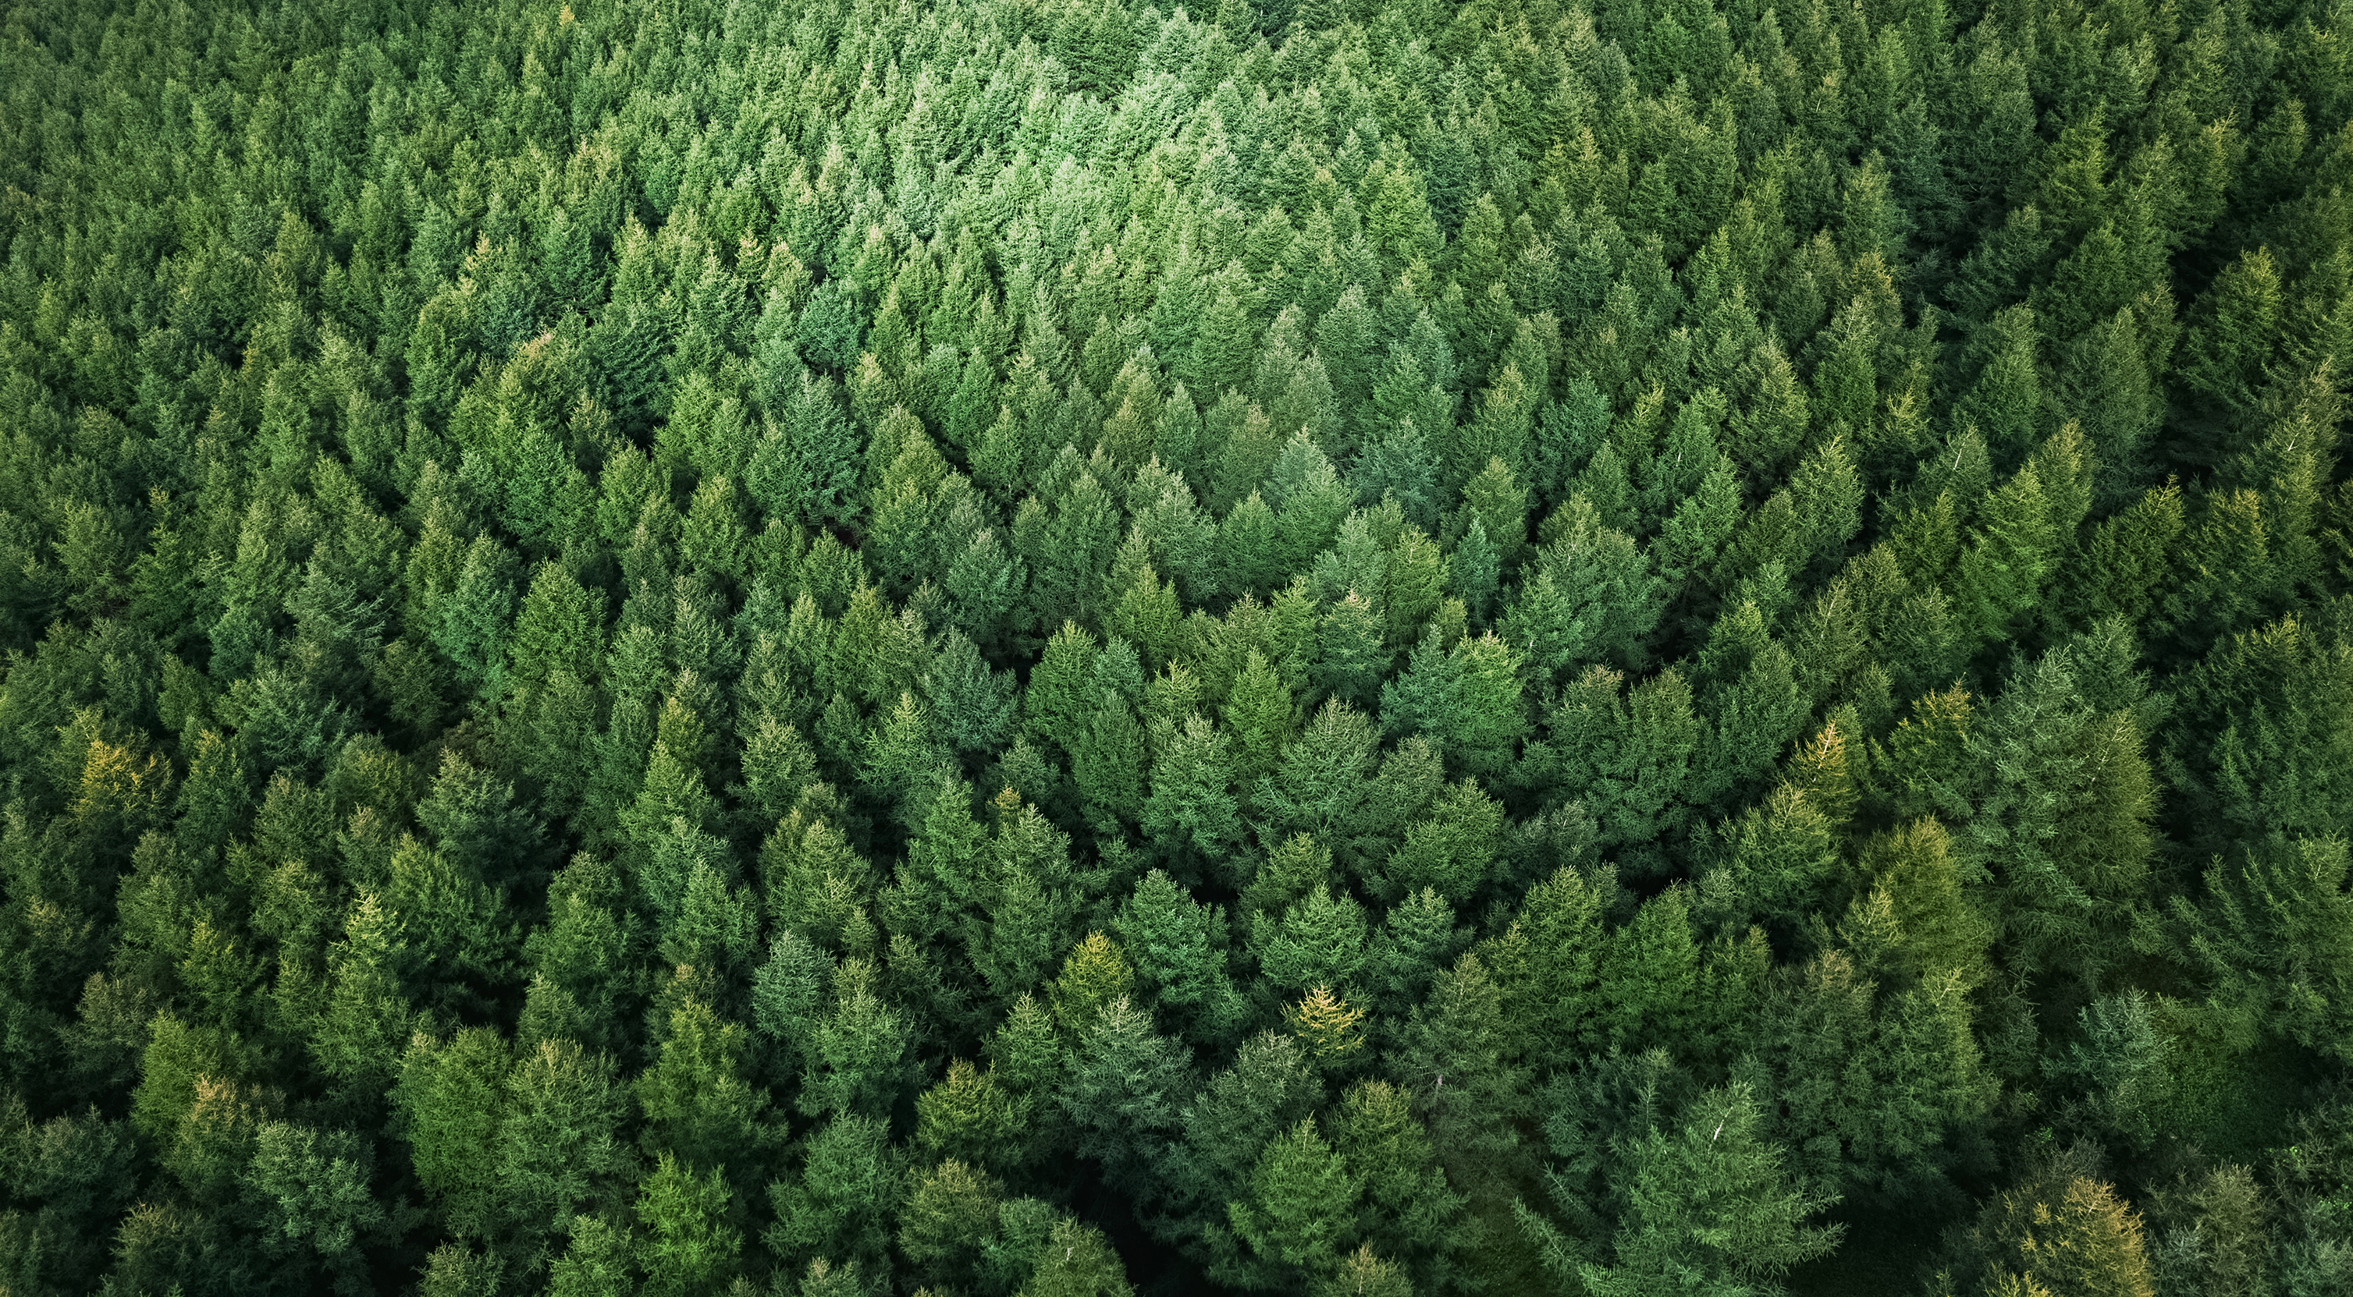
Forest

Slide 4

Random

Slide 5
Random Forest
Random forest is a Supervised Machine Learning Algorithm that is used widely in Classification and Regression problems
Bagging
Ensemble Technique
Boosting

Slide 6
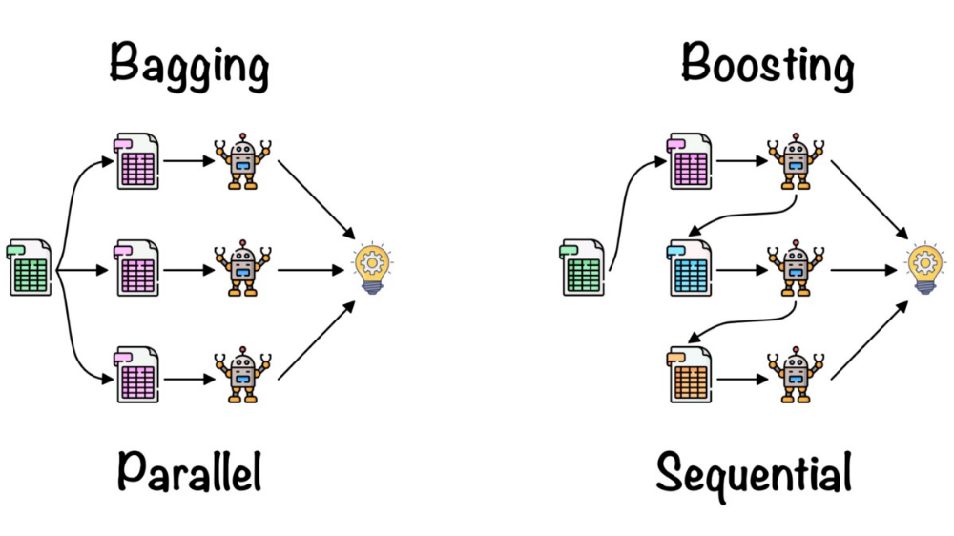

Slide 7
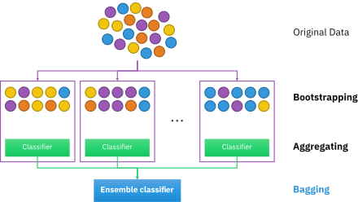
Bagging
Bootstrap Aggregation

Slide 8
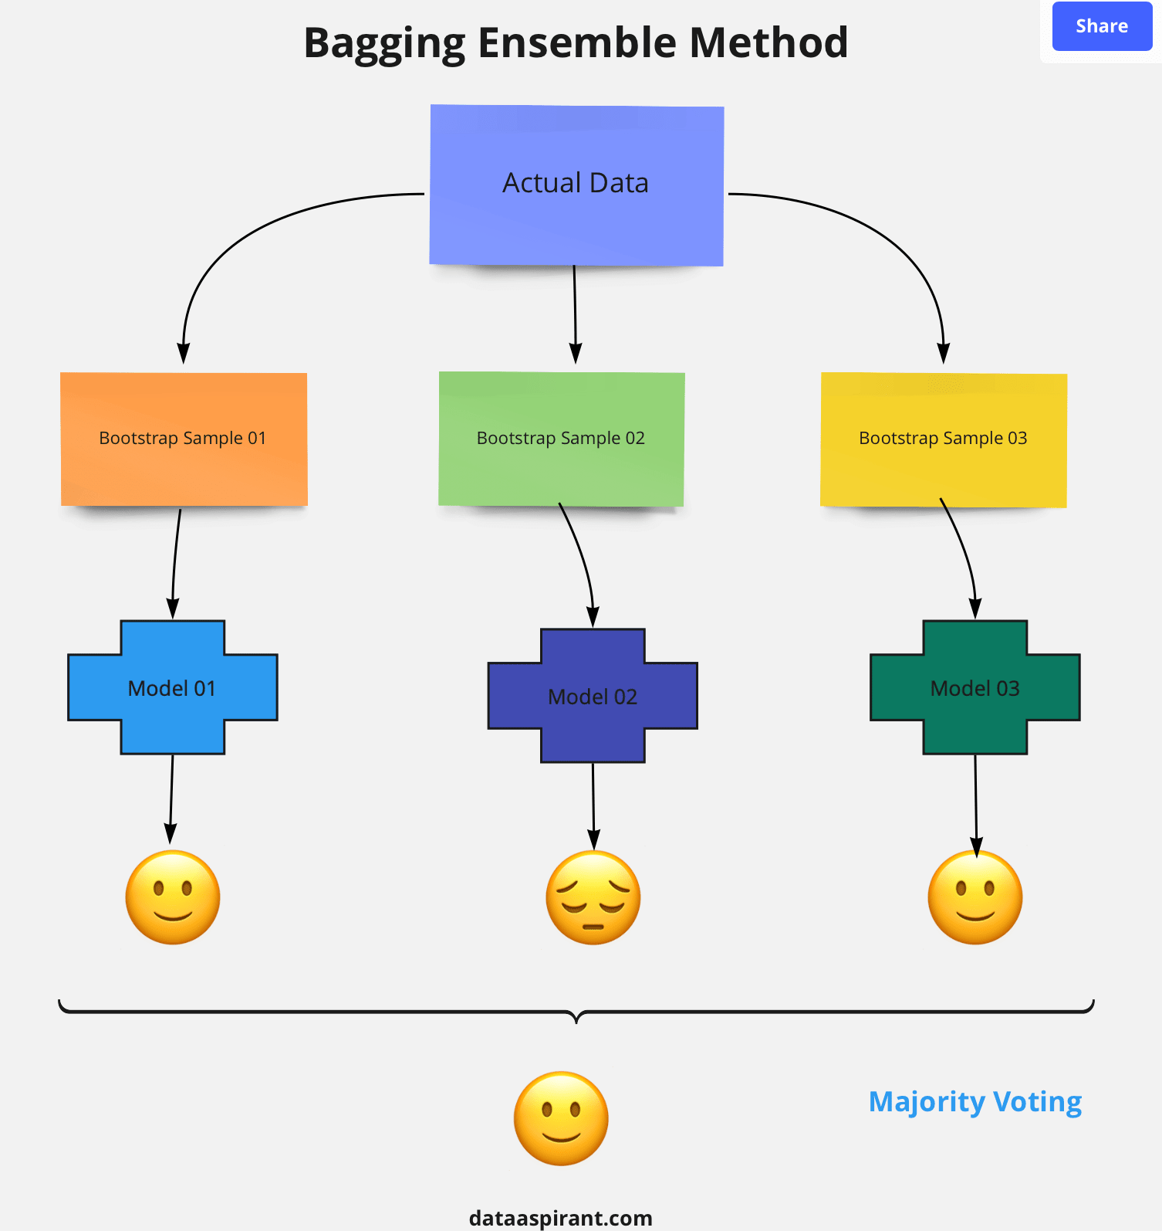

Slide 9
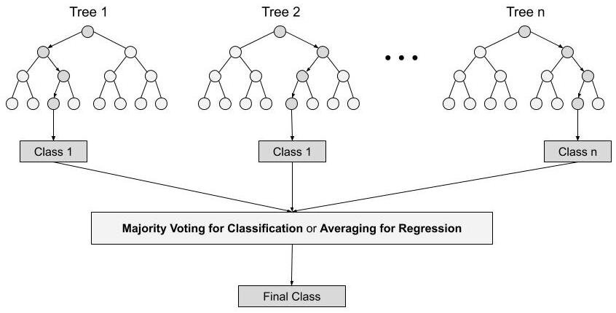

Slide 10
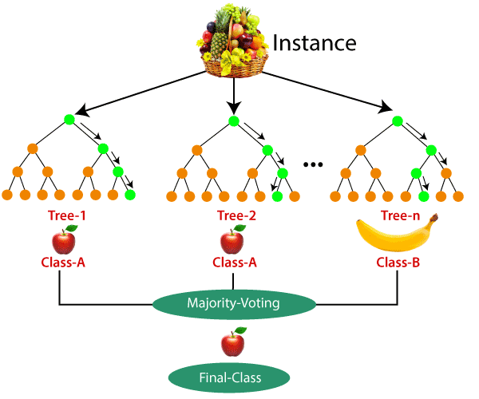

Slide 11

Should I bought iphone or NO ??

Slide 12

Friend-1
Friend-2
Friend-n
Yes
NO
Yes
Yes

Slide 13

Let’s Code

